Slide 1

TEAM Rose&Jack
Isabelle Kluser
Andreas Palm
Reto Stucki
05.11.2018

Slide 2
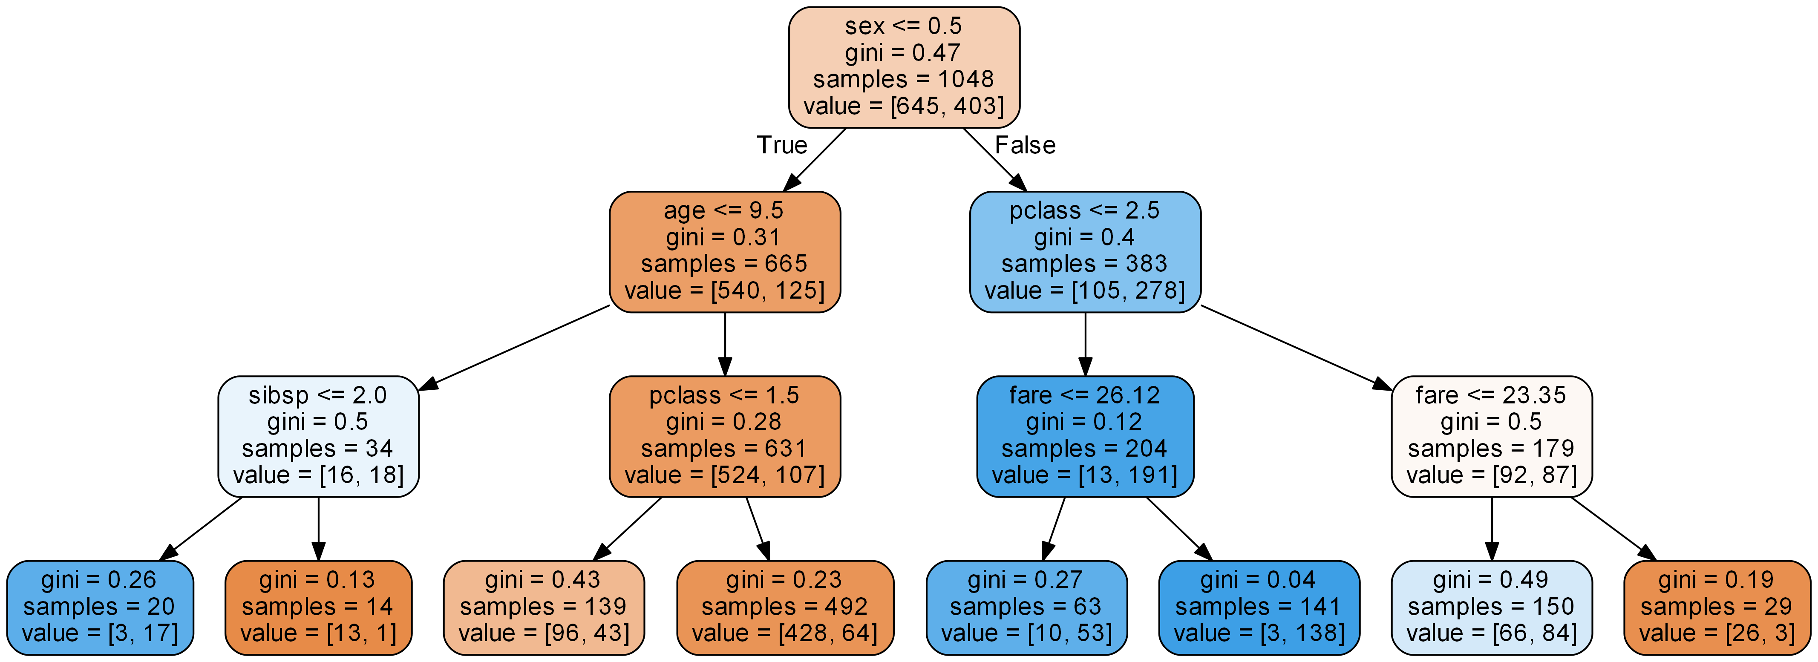
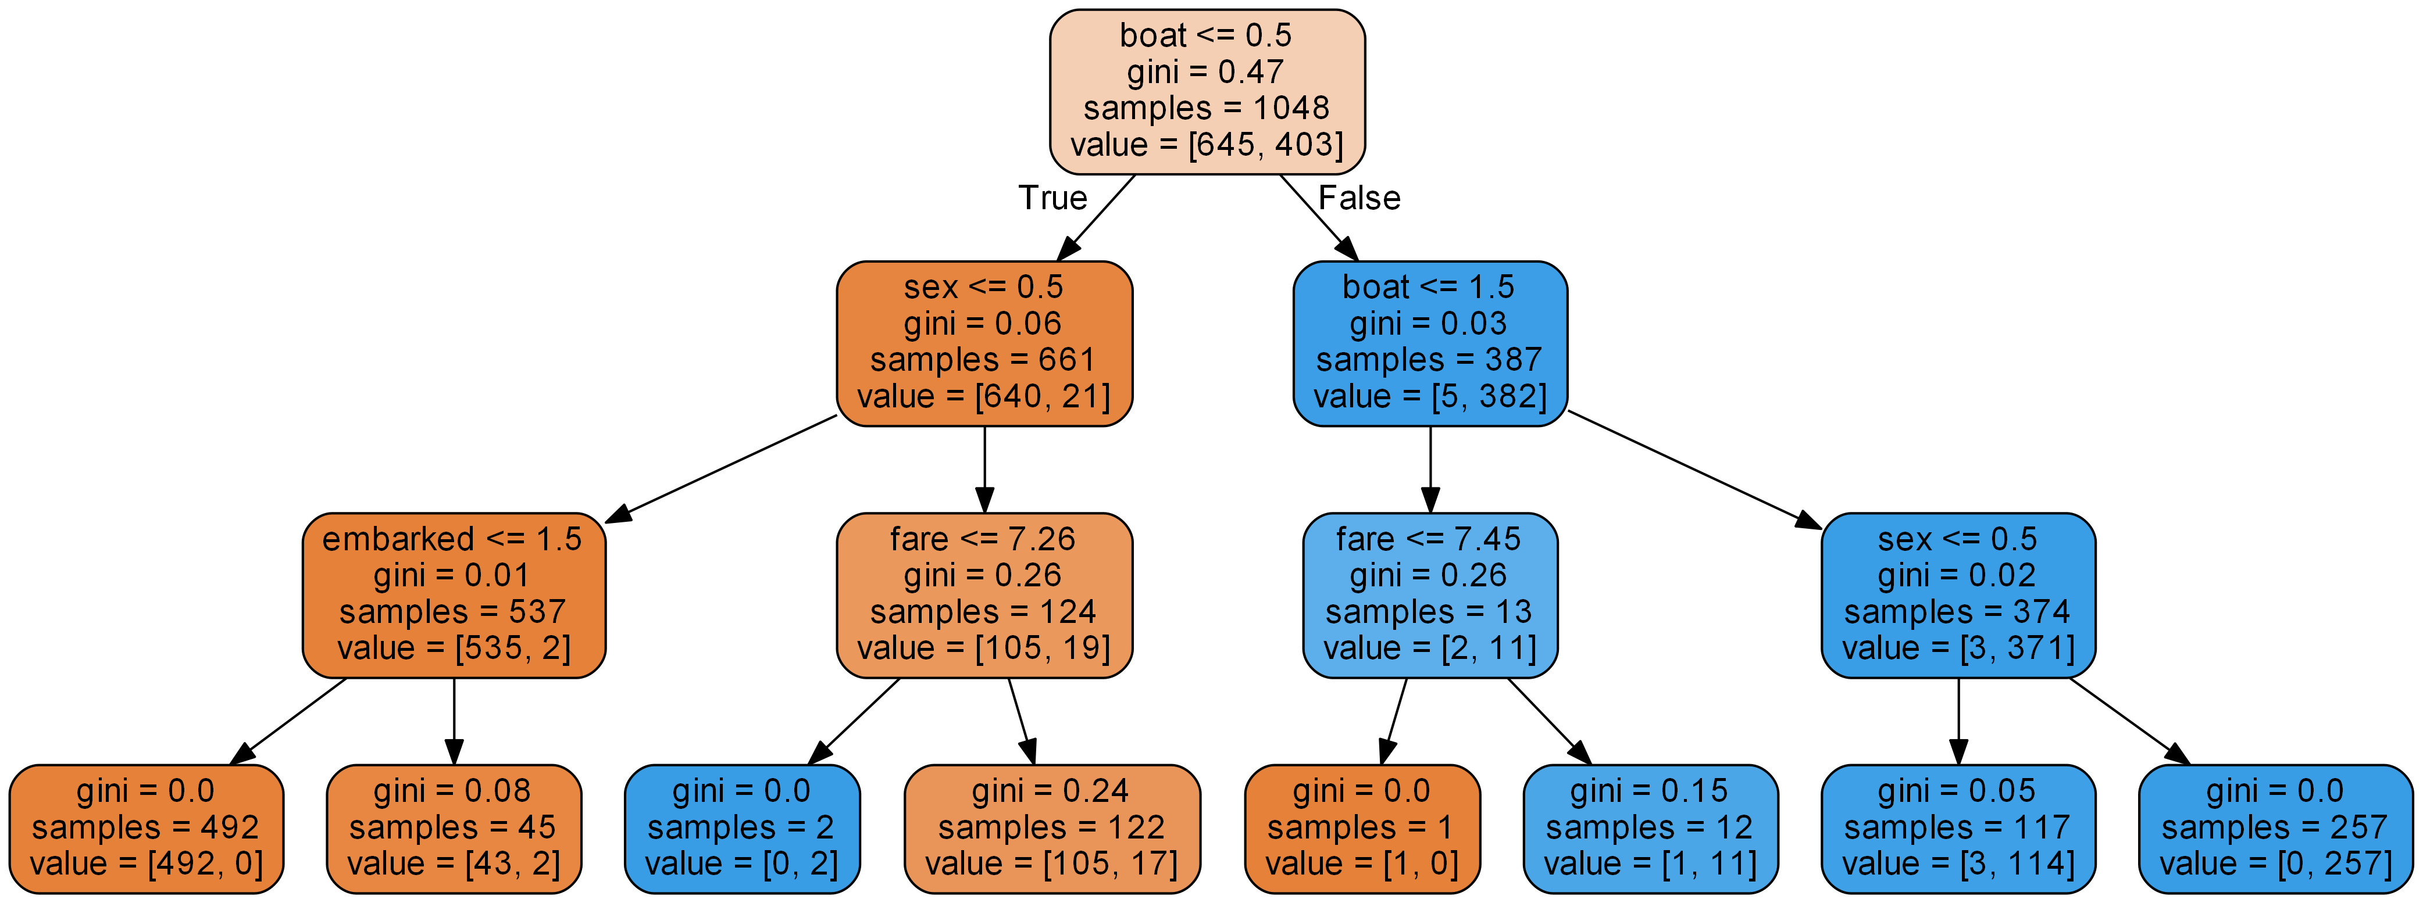
Pre vs. Post
Pre 0.82
Post 0.97 (with boat)
Pre suggests that gender might be the key to survive (Men 18.7% vs Women 72.5%)
However Post shows survival rate if not in a boat 1.29%

Slide 3
Technology
Moduls used:
Pandas
Sklearn (decision tree)
l_util (self-written for all data cleansing tasks)
l_plot (self-written for all plotting & analysis tasks)
Path (to make code OS independent)
Algo selected: decision tree
Reason: Visualisation of decision tree makes things transparent
Source Code sunken at: https://github.com/nojetlag/CASINFE2018/tree/master/Titanic
Notes:
¨

Slide 4
Learnings
Initially had 3 different approaches, as team decided to go with decision tree => not a black box
Taking time to understand results
Decision tree depth is very important (best results @3 for this case)
Team collaboration is much easier when using a common repository
Isa focused on the graphics and analysis part
Reto focused on the data cleansing
Andreas focused on the code clean up and os independent parts
Coordination via Slack
Make code OS agnostic (file paths)
Notes:
Decision Trees:
+
Simple to understand and to interpret. Trees can be visualised.
Requires little data preparation. Other techniques often require data normalisation, dummy variables need to be created and blank values to be removed.
Performs well even if its assumptions are somewhat violated by the true model from which the data were generated
Uses a white box model. If a given situation is observable in a model, the explanation for the condition is easily explained by boolean logic. By contrast, in a black box model (e.g., in an artificial neural network), results may be more difficult to interpret
-
Decision-tree learners can create over-complex trees that do not generalise the data well. This is called overfitting.
Decision tree learners create biased trees if some classes dominate. It is therefore recommended to balance the dataset prior to fitting with the decision tree

